Slide 1
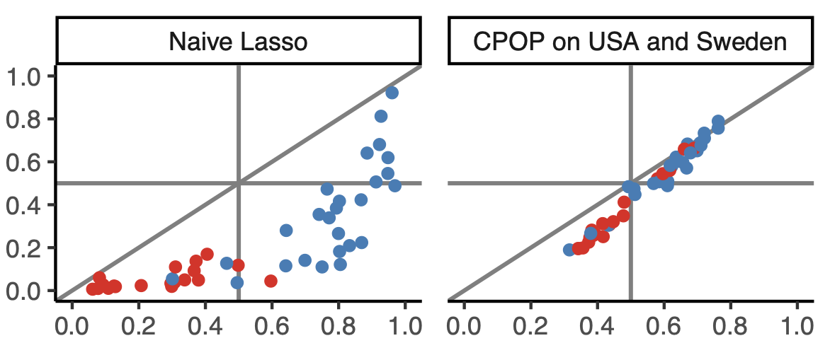
Cross-Platform Omics Prediction (CPOP)
Kevin YX Wang¹, Gullietta Pupo², Varsha Tembe², Graham Mann^{2,3}, Garth Tarr¹, Samuel Mueller¹, Jean Yang¹
1 School of Mathematics and Statistics, The University of Sydney
2 Melanoma Institute Australia, The University of Sydney, North Sydney, Australia
3 The John Curtin School of Medical Research, Australian National University
Motivation
Methods
Results
When implementing a prediction model in the clinics, what is more important?
Classification accuracy or stability of prediction?
CPOP is a statistical procedure that enables prediction using omics data in a clinical settings.
CPOP avoids re-normalisation of additional data through the use of log-ratio features and thus also enable prediction for single omics samples.
The novelty of the CPOP procedure lies in its ability to construct a transferable model across gene expression platforms and for prospective experiments.
Such a transferable model can be trained to make predictions on independent validation data with an accuracy that is similar to a re-substituted model.
We tested CPOP on four late-stage melanoma datasets.
MIA-2015 (Jayawardana et al. 2015)
MIA-2018 (Unpublished)
USA (TCGA 2015)
Sweden ((Cirenajwis et al. 2015)
Which one is more widely reported in publications?
Equivalent predictions
Stable prediction
=
stable features
+
stable modelling
Predicted risk probability
in MIA-2015
Predicted risk probability in MIA-2018
Accuracy: 0.63 Avg. deviation: 15%
Accuracy: 0.81 Avg. deviation: 5%
Due to experimentation constrains, we might not be able to normalise our data and use the standard prediction model like Lasso and Random Forest.
High prediction accuracy
How does CPOP work?
Weight each feature by its stability across datasets
Select only features with similar estimated coefficients across datasets

